Slide 1
An Introduction to MongoDB
By Noah Constable, Biruk Mengistu, and Kyle Day

Slide 2
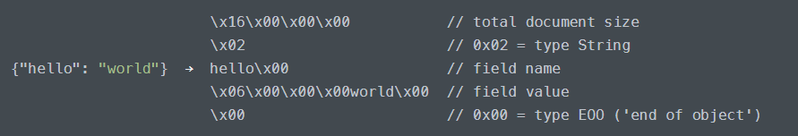
Background
BSON
Binary JSON
Additional data types
Binary
Regex
Arrays
Better speed, worse storage
Length, index prefixes
NoSQL (Not Only SQL)
Documents
Schemaless

Slide 3
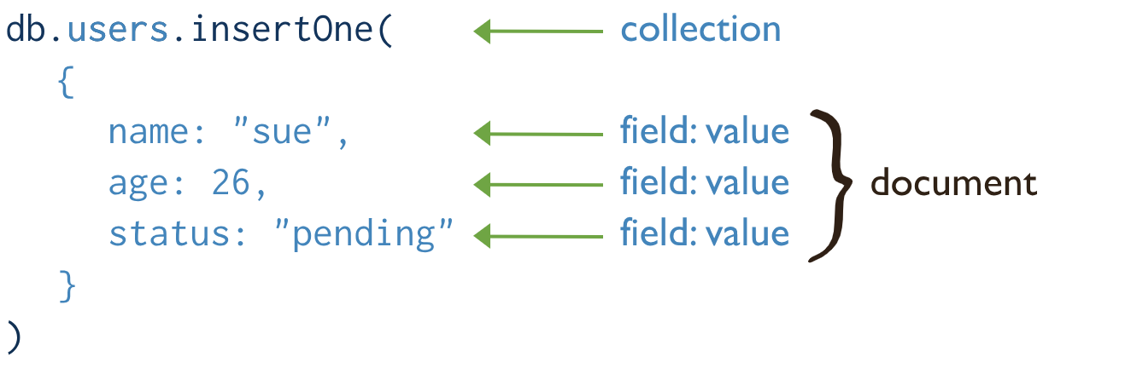
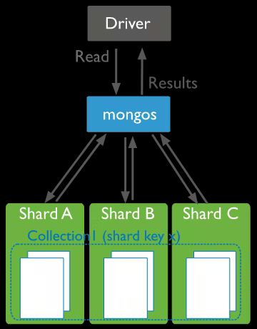
Key Features
Document-Oriented
Varying data structures
Scalable and Distributed
Horizontal scaling
Split storage
Performance
Fault tolerance
Sharding
Performance
Optimized for read/write
BSON
Caching
Flexible Data Models
NoSQL

Slide 4
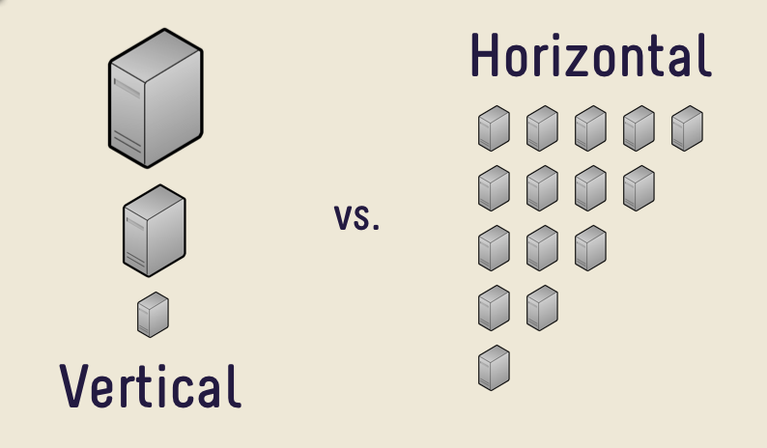

Slide 5
Key Features
Document-Oriented
Varying data structures
Scalable and Distributed
Horizontal scaling
Split storage
Performance
Fault tolerance
Sharding
Performance
Optimized for read/write
BSON
Caching
Flexible Data Models
NoSQL

Slide 6
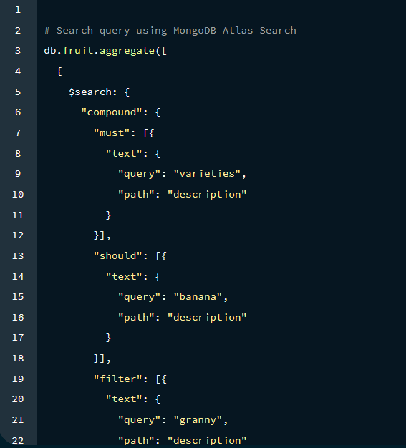
Key Features cont.
4. MongoDB Query Language
Complex operations
Queries
Aggregations
Joins
Data Analysis
5. Security
Auth
RBAC
SSL
Audit Logs

Slide 7
In Layman’s Terms
Rephrase and summarize, if you have an application that is not:
Handling transactional data
Performing complex operations
Very dependent on consistent data types and schemas
then Mongo might not be your solution!
Mongo:
Scales better
Is much more flexible with data types
Outperforms for simpler operations

Slide 8
MongoDB Architecture

Slide 9
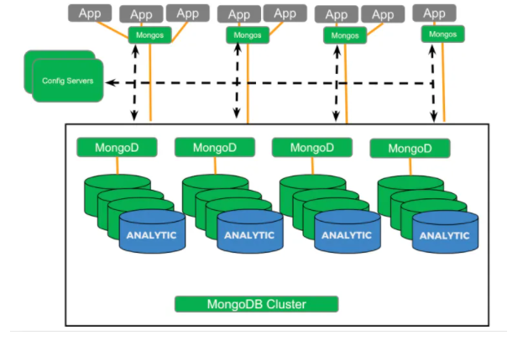
Components of the MongoDB Architecture
Primary Nodes (mongos)
Secondary Nodes
Sharding
Load Balancing
Config Servers
Analytic Nodes

Slide 10
Components of the MongoDB Architecture
Primary Nodes (mongos)
Act as a query router
Handle load balancing
Route client requests to the appropriate shard based on the shard key
Ensures high availability and fault tolerance

Slide 11
Components of the MongoDB Architecture
Sharding
Technique used to horizontally partition data across multiple servers or nodes
Data is divided into smaller, more manageable chunks called shards
Sharding allows for distributing data and workload across multiple nodes, providing better scalability and performance

Slide 12
Components of the MongoDB Architecture
Secondary Nodes
Used for redundancy and high availability
Replicate data from primary nodes
Provide read access to clients
Can be promoted to primary in the event of a primary node failure

Slide 13
Components of the MongoDB Architecture
Config Server
Stores metadata and configuration information for the entire cluster
Keeps track of the cluster topology, shard key ranges, and other configuration details

Slide 14
Components of the MongoDB Architecture
Analytic Nodes
Stores metadata and configuration information for the entire cluster
Keeps track of the cluster topology, shard key ranges, and other configuration details

Slide 15
CRUD Guide

Slide 16
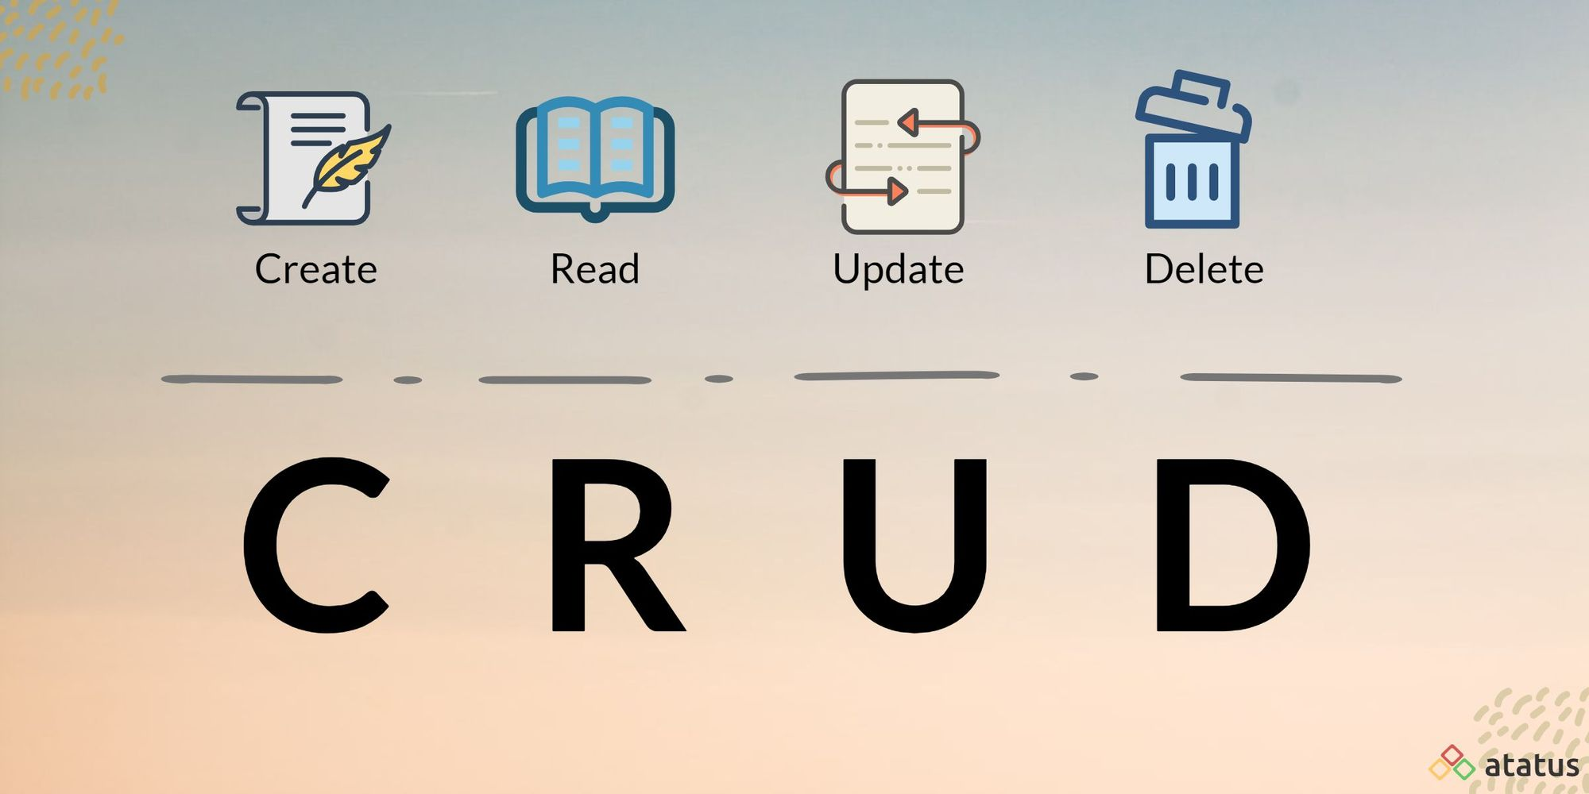
CRUD Overview

Slide 17
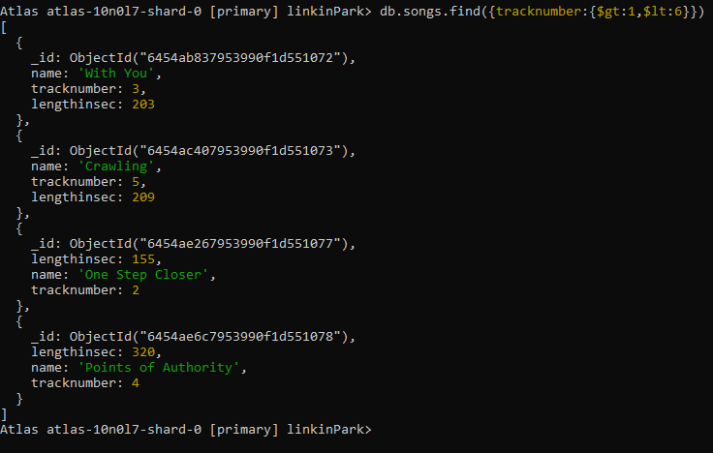
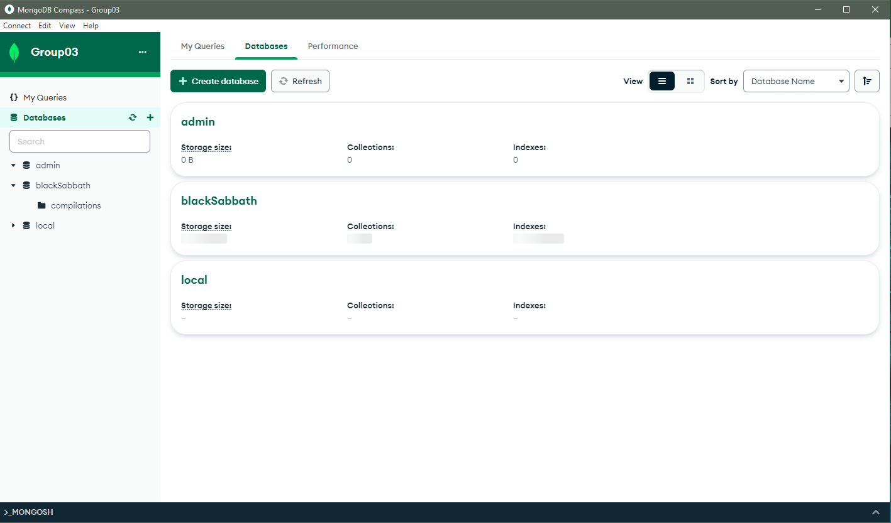
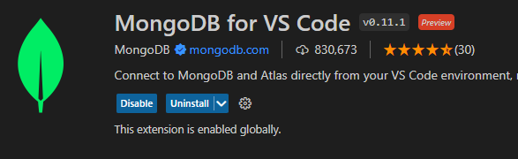
CRUD Overview
CRUD operations can be performed in:
MongoDB Compass (GUI)
MongoShell or Atlas (CLI)
Several IDEs (e.g., VSCode via the MongoDB extension)

Slide 18
Rules for Creating Databases and Collections
All databases require at least one collection
Collections have mutually exclusive types:
Time-series collections allow for sorting via time
Capped collections limit the collection’s size
Clustered collections are used for optimizing performance
String rules (e.g., locale, alternate, backwards, etc.) can be enforced through custom collation

Slide 19
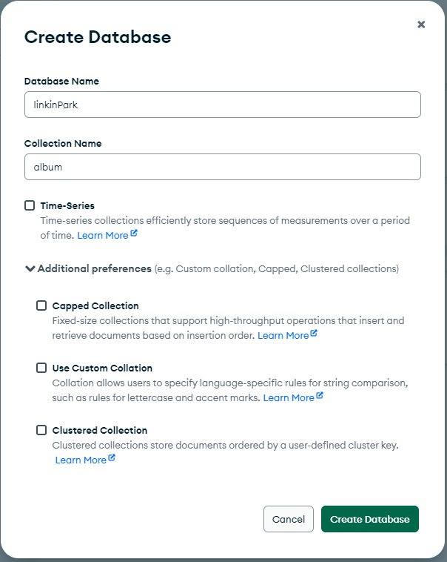
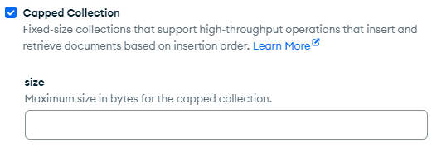
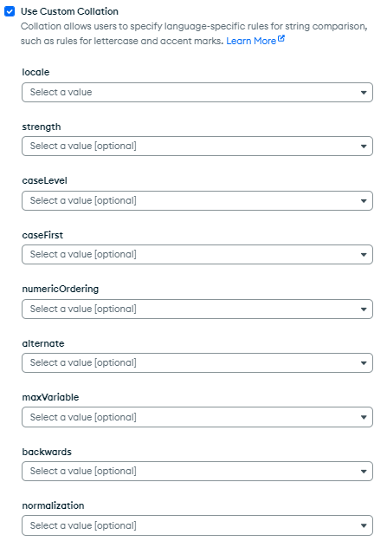
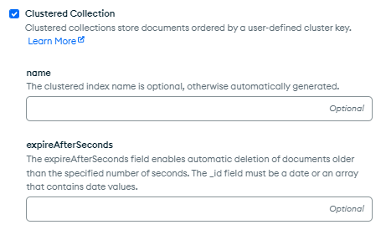
Creating Databases and Collections - Compass

Slide 20
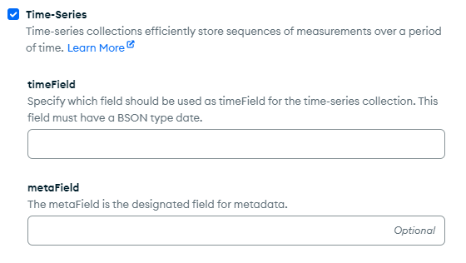
Creating Databases and Collections - Compass

Slide 21
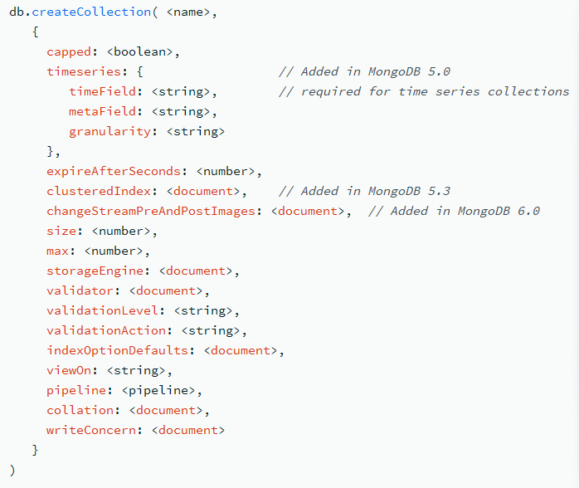
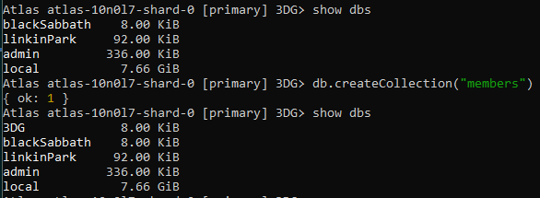
Creating Databases and Collections - Atlas
Creating a database is as simple as using use <name> (disappears in the shell)
Creating a collection can be simple or complex
Just a name
A name and several options
Several options are documents

Slide 22
Overview for Creating Documents
Inserted manually if via CLI
Each document has a unique object identifier
OID permits references like SQL keys

Slide 23
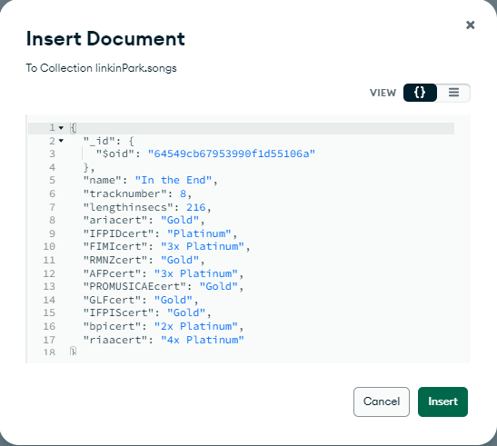
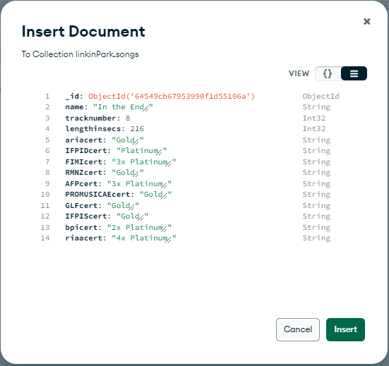
Creating Documents - Compass
Provides JSON and row-based insertion
A similar UI is used for updating documents
Disclaimer: Compass’ linter breaks fairly often

Slide 24
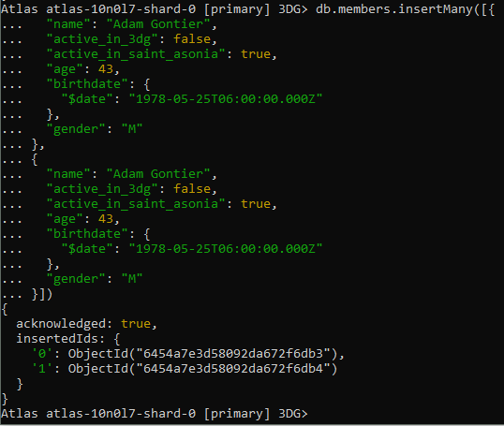
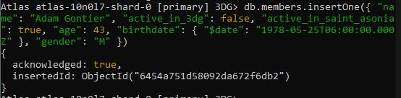
Creating Documents - Atlas
There are two insertion commands:
db.<collectionname>.insertOne(<document>)
db.<collectionname>.insertMany([<document>, …])
The console generally will generate an OID

Slide 25
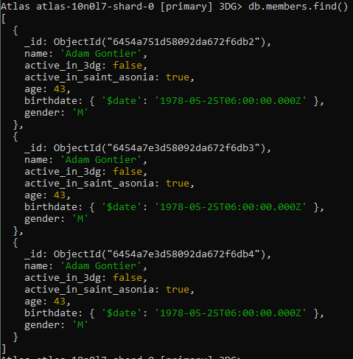
Reading Documents
db.<collectionname>.find() can be used to find all documents in a collection
Documents are listed in order of creation

Slide 26
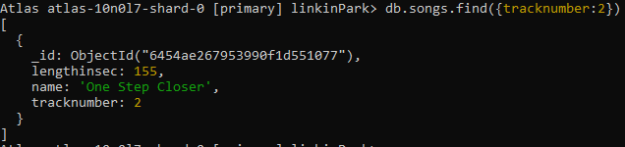
Reading Documents
Parameters may be used to narrow down searches (like select in SQL)
db.<collectionname>.find(<filter>)

Slide 27
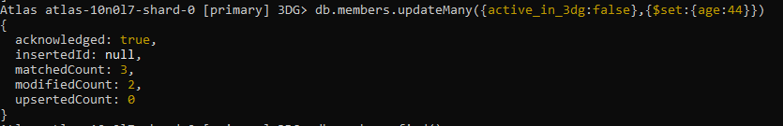
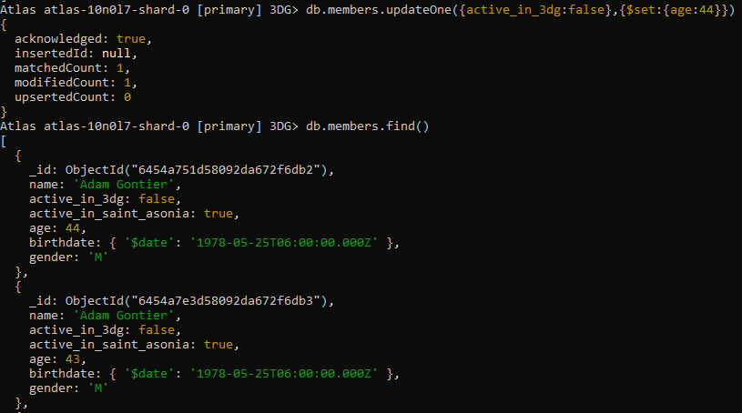
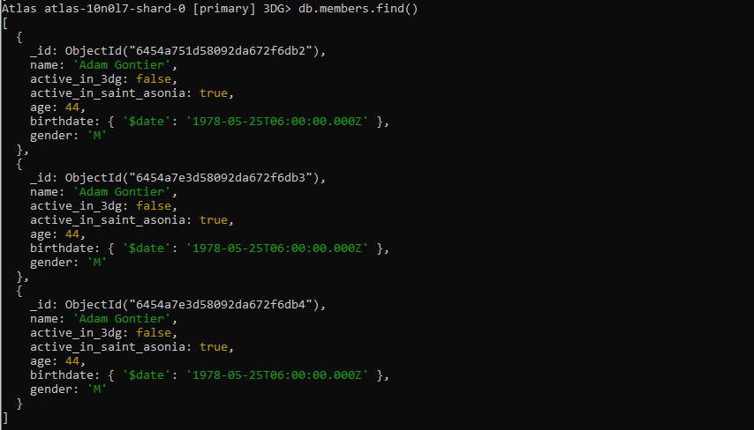
Updating Documents
There are two update methods for documents:
db.collection.updateOne(<filter>, <change>)
db.collection.updateMany(<filter>, <change>)

Slide 28
Updating Documents
There are two update methods for documents:
db.collection.updateOne(<filter>, <change>)
db.collection.updateMany(<filter>, <change>)
Compass does not implement the latter

Slide 29
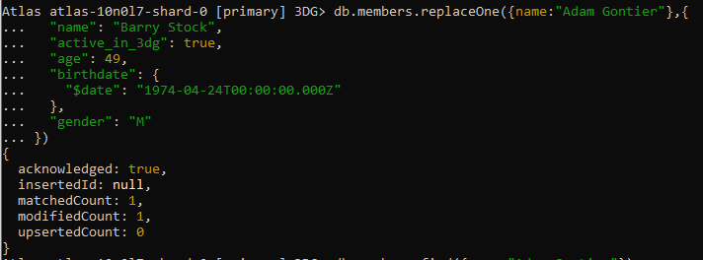
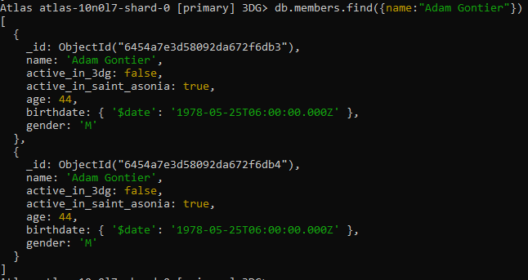
Updating Documents
db.collection.replaceOne(<filter>, <document>) replaces one document with another

Slide 30
Updating Documents
db.collection.replaceOne(<filter>, <document>) replaces one document with another
Not available via Compass

Slide 31
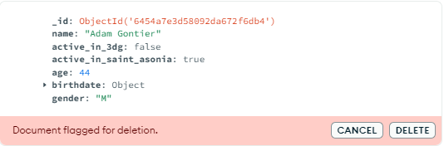
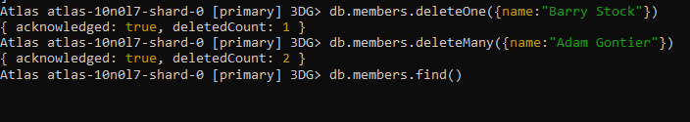
Deleting Documents
Compass marks documents prior to deletion
There are two deletion methods via code:
db.<collection_name>.deleteOne()
db.<collection_name>.deleteMany()

Slide 32
Deleting Documents
There are two deletion methods:
db.<collection_name>.deleteOne(<filter>)
db.<collection_name>.deleteMany(<filter>)

Slide 33
Deleting Documents
Compass marks documents prior to deletion
There are two deletion methods via code:
db.<collection_name>.deleteOne(<filter>)
db.<collection_name>.deleteMany(<filter>)

Slide 34
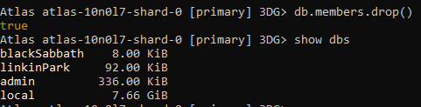
Deleting Collections
The method to delete collections is db.<collection_name>.drop()
If the only collection in a database is dropped, the database will be dropped as well

Slide 35
Deleting Collections
Collections can be deleted from the sidebar in Compass
Collection name must be inputted to confirm
Via coding: db.<collection_name>.drop()
If the only collection in a database is dropped, the database will be dropped as well

Slide 36
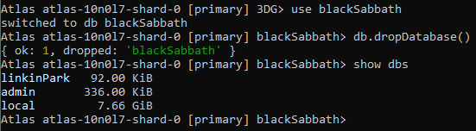
Deleting Databases
Databases can be deleted via db.dropDatabase()

Slide 37
Deleting Databases
Databases can also be deleted from the sidebar in Compass - with confirmation
Via coding: db.dropDatabase()

Slide 38
Compatibility and Integration

Slide 39
Compatibility
MongoDB is used with various programming languages
Java
Typescript
Many more
Several frameworks are also compatible
Angular
Django
Many more

Slide 40
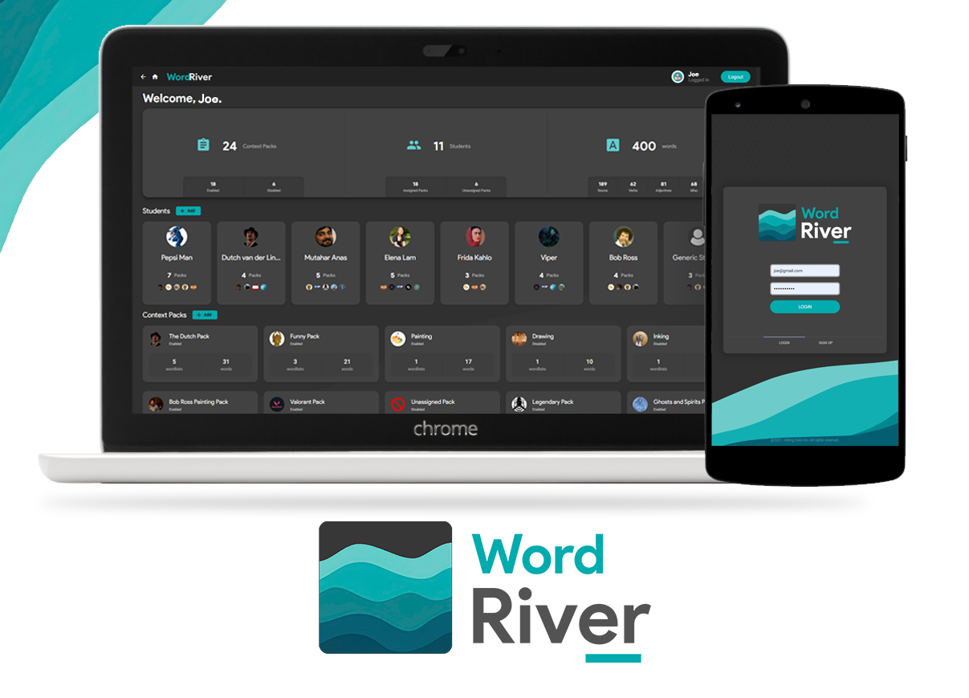
Example: WordRiver from Software Design
WordRiver is an Angular, Java, and Typescript-based application
It groups word lists based on subject matter and lets teachers/parents assign them to students

Slide 41
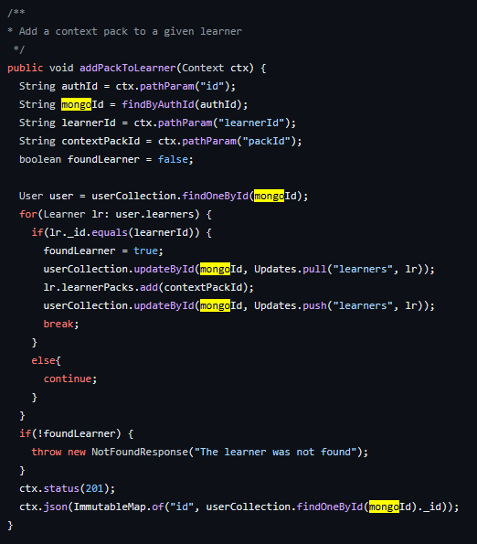
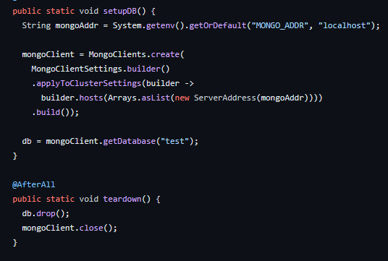
Example: WordRiver from Software Design
MongoDB is used extensively as a database

